Slide 1





Wallpaper for fun
Virtual backgrounds for Microsoft Teams video calls

Slide 2

Wallpaper for fun 1

Slide 3

Wallpaper for fun 2

Slide 4

Wallpaper for fun 3

Slide 5
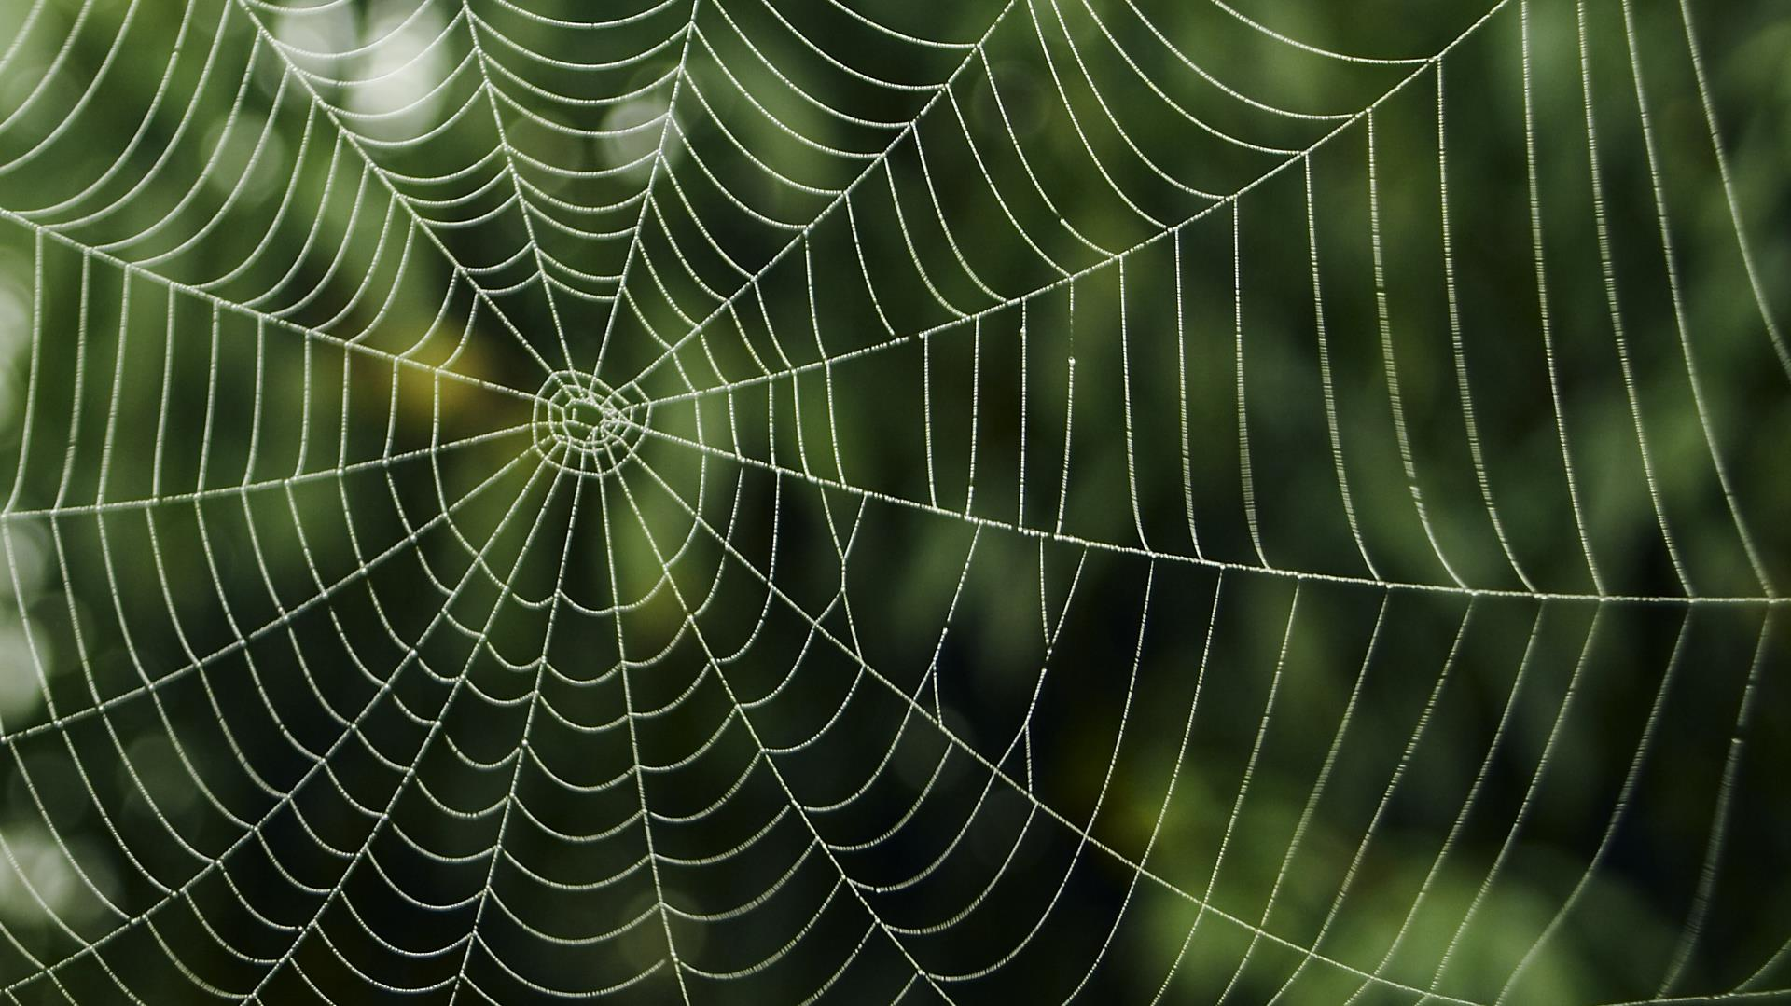
Wallpaper for fun 4

Slide 6

Wallpaper for fun 5

Slide 7
Help
Save the background
To add one of these backgrounds to a video call, you’ll first need to save it as a picture to a location where you can easily find it when you add it to Teams. To save the background:
Select the background, right-click it, and then click Save as Picture.
In the Save as type list, select the file format that you want. Make sure it’s a .JPG, .PNG, or .BMP file.
In the File name box, accept the suggested file name, or if you like, type a new name for the picture.
Select the folder where you want to store the image. For example, choose your Documents folder or your Desktop.
Click Save.
Change your background before a meeting starts
While you’re setting up your video and audio before joining a meeting:
Select Background settings. It’s the icon just to the right of the mic switch. Your Background Settings options will display on the right.
Choose Add new and then select the background you just saved as a picture to upload from your computer. You will now see it behind you in the Teams video window, as well as a new background available in Background Settings.
Change your background during a meeting
To change your background after you’ve already joined a meeting:
Go to your meeting controls and select More actions *** > Show background effects.
Choose Add new and then select the background you just saved as a picture to upload from your computer. You will now see it behind you in the Teams video window, as well as a new background available in Background Settings.

